Slide 1

Museum Database
By Josh Engle and Sam Kondall

Slide 2
Abstract
For the final project, we will be cataloging artifacts from Miami Valley Veterans Museum. These items will each be given an individual id and given the following attributes, what kind of artifacts the item is such some from of clothing or a flag, the time-period the item comes from, item national origin, where it was, an approximation of cost, condition, size, date added to the museum and person who donated the item. The expected user, that being people working at the museum, is to be able to find the item, find the donor, find what era the item came from, what exactly is it, when it was added to the museum’s collection, approximant cost, country it was found in, its national origin, current condition, size of the item and sort by any of descriptors listed above. The system should be able to handle up to 2000 different artifacts. In addition, there will be a very simple list the name of the donor, their address and both their phone number and email.

Slide 3
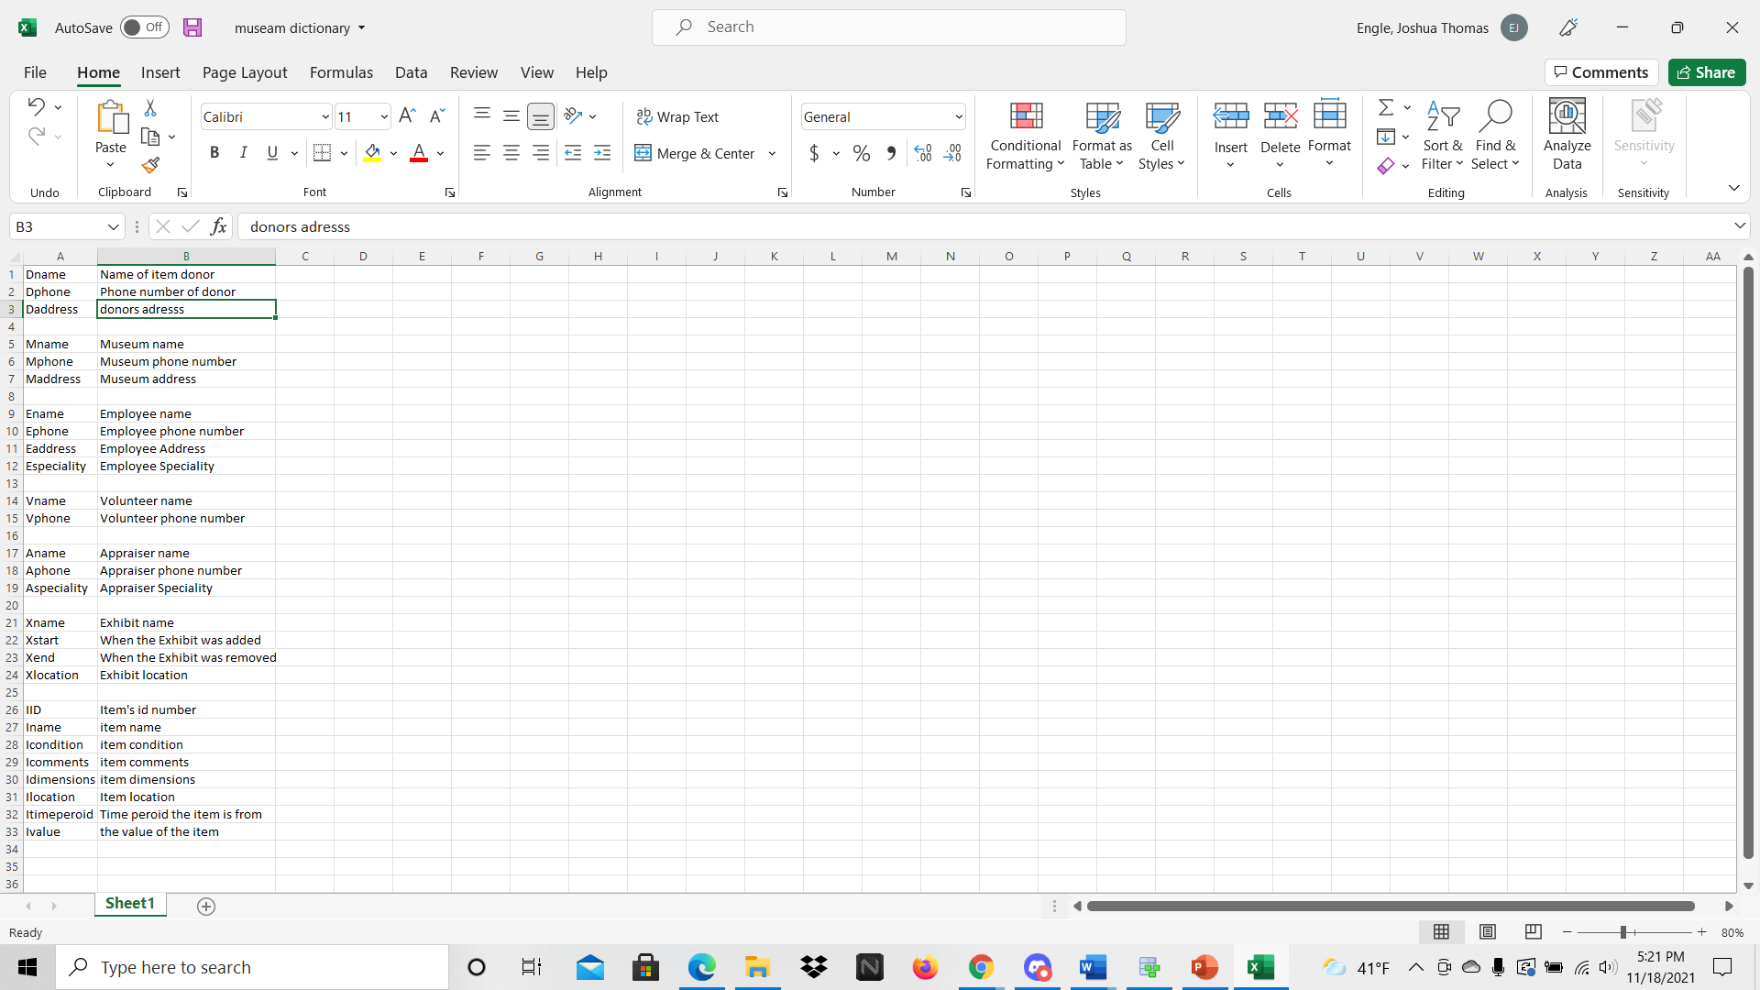
Data dictionary

Slide 4
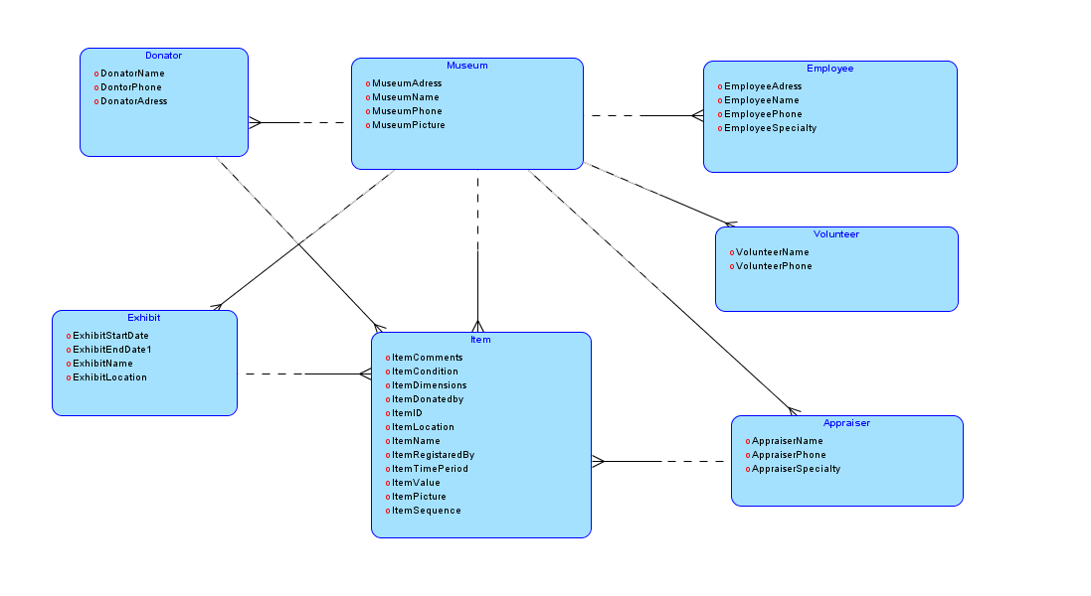
ERD

Slide 5
Relational Schmea
Donator(DName, DPhone, DAddress,)
Museum(MName, MPhone, MAddress)
Employee(EName, EPhone, EAddress, ESpecialty)
Volunteer(VName, VPhone)
Appraiser(AName, APhone, ASpecialty)
Exhibit(XName, XStart, XEnd, XLocation)
Item(IID, IName, ICondition, DName, AName, XName, IComments, IDimensions, ILocation, ITimeperoid, IValue)

Slide 6
DDL
Made DDL using generated script from ERD and then made changes to var names / other minor tweaks

Slide 7
DML
Wrote code to add a few entries from a Preexisting excel inventory sheet of a museum.
About 2000 entry’s in total in the file, so we only added 5 entries instead

Slide 8
Queries, PL/SQL and view
Simple code to join 3 tables with the same variable
The DML mentioned above
Code to add the total value of the items in the museum
Code to find the most expensive item in the museum

Slide 9
Best statement

Slide 10
Lesson learned
Always have back up plan
Always write down passwords somewhere
A good Github repo helps everyone stay organized

Slide 11
Exam question
True or False, A 3NF Schema can only have one Foreign key per a table.

Slide 12
Exam Question answer
False, it can have as many as needed

